Slide 1

Project Review presentation on
“ Predicting next word in a sentence using Recurrent Neural Network “
Presented By
Group ID – B8
Mr. Zaid Shaikh (4251)
Mr .MohammadAayan Pathan (4221)
Mr .MuaazKhan Pathan (4222)
Mr. Avinash Waghmare (4275)
Project Guide
Prof. A.N.Nawathe
AMRUTVAHINI COLLEGE OF ENGINEERING,SANGAMNER
DEPARTMENT OF COMPUTER ENGINEERING
2022-2023

Slide 2
Contents
Requirement Analysis
System Architecture
Data Flow Diagram
Class Diagram
Use case Diagram
Sequence Diagram
Activity Diagram

Slide 3
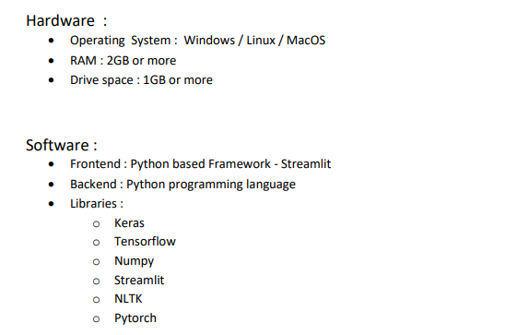
Requirement Analysis

Slide 4
System Architecture

Slide 5
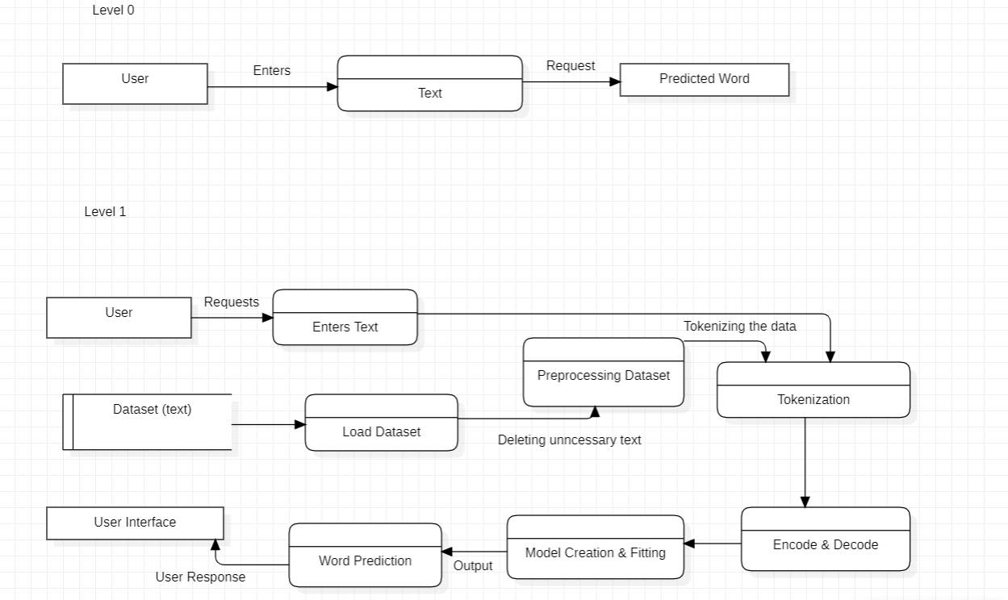
Data Flow Diagram
A data flow diagram shows the way information flows through a process or system .

Slide 6
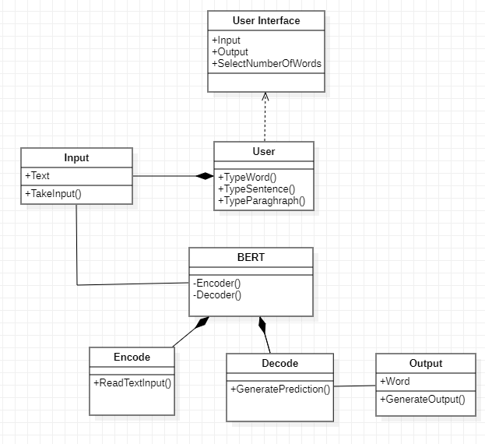
Class Diagram :
A class diagram shows classes in their relation and their properties and methods .

Slide 7
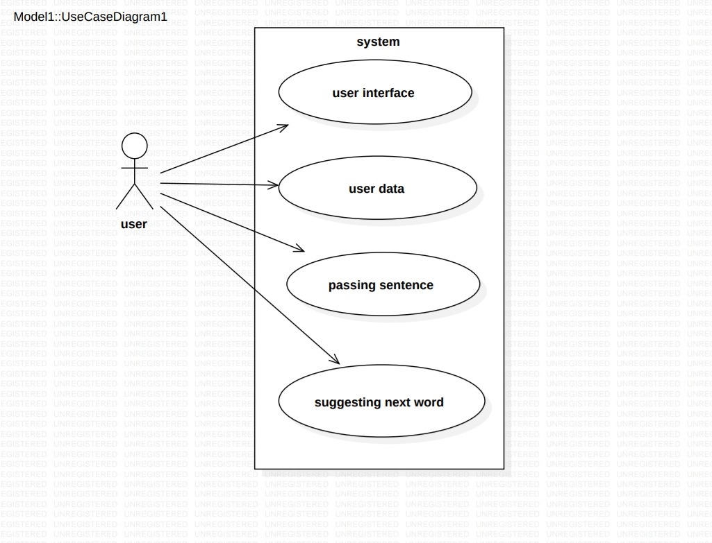
Use case Diagram :
A use case diagram is a graphical depiction of a user's possible interactions with a system.

Slide 8
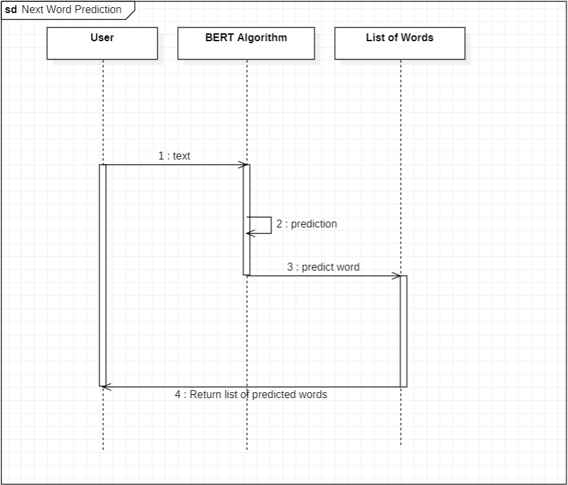
Sequence Diagram :
A sequence diagram or system sequence diagram shows process interactions arranged in time sequence in the field of software engineering.

Slide 9
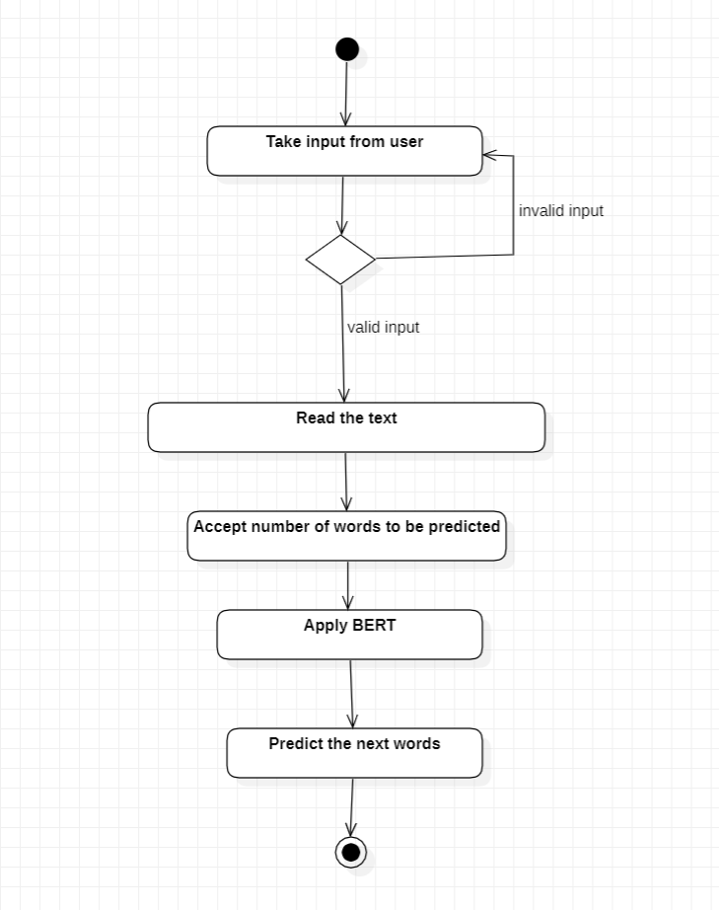
Activity Diagram :
An activity diagram visually presents a series of actions or flow of control in a system similar to a flowchart or a data flow diagram.

Slide 10
Thank You!

